Slide 1
Data Mining Techniques
Presentation By
Shano Solanki
Asst. Professor, CSE,
NITTTR, Chandigarh

Slide 2
Prerequisites
Knowledge of
  Basic probability theory
  Algorithms and complexity analysis
  Statistical Methods

Slide 3
Teaching materials
Reference texts:
  Data mining: Concepts and Techniques, by Jiawei Han and Micheline Kamber, Morgan Kaufmann, ISBN 1-55860-489-8.
  Principles of Data Mining, by David Hand, Heikki Mannila, Padhraic Smyth, The MIT Press, ISBN 0-262-08290-X.
  Introduction to Data Mining, by Pang-Ning Tan, Michael Steinbach, and Vipin Kumar, Pearson/Addison Wesley, ISBN 0-321-32136-7.
  Machine Learning, by Tom M. Mitchell, McGraw-Hill, ISBN 0-07-042807-7
  Modern Information Retrieval, by Ricardo Baeza-Yates and Berthier Ribeiro-Neto, Addison Wesley, ISBN 0-201-39829-X
Data mining resource site: KDnuggets Directory

Slide 4
Topics
Introduction
Data pre-processing
Association rule mining
Classification (supervised learning)
Clustering (unsupervised learning)
Post-processing of data mining results
Text mining
Partial/Semi-supervised learning
Introduction to Web mining

Slide 5
Introduction to Data Mining

Slide 6
What is data mining?
Data mining is also called knowledge discovery and data mining (KDD)
Data mining is
  extraction of useful patterns from data sources, e.g., databases, texts, web, image.
Patterns must be:
  valid, novel, potentially useful, understandable

Slide 7
Examples: What is (not) Data Mining?
What is not Data Mining?
  Look up phone number in phone directory
  Query a Web search engine for information about “Amazon”
What is Data Mining?
  Certain names are more prevalent in certain US locations (O’Brien, O’Rurke, O’Reilly… in Boston area)
  Group together similar documents returned by search engine according to their context (e.g. Amazon rainforest, Amazon.com,)

Slide 8
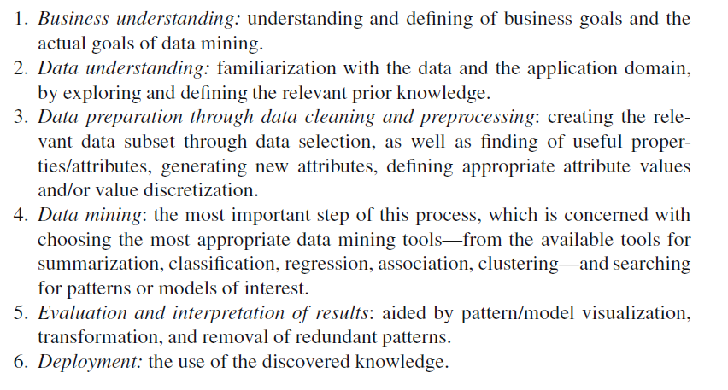
Knowledge Discovery Process

Slide 9
Data Mining: Classification Schemes
Decisions in data mining
  Kinds of databases to be mined
  Kinds of knowledge to be discovered
  Kinds of techniques utilized
  Kinds of applications adapted
Data mining tasks
  Descriptive data mining
  Predictive data mining

Slide 10
Decisions in Data Mining
Databases to be mined
  Relational, transactional, object-oriented, object-relational, active, spatial, time-series, text, multi-media, heterogeneous, legacy, WWW, etc.
Knowledge to be mined
  Characterization, discrimination, association, classification, clustering, trend, deviation and outlier analysis, etc.
  Multiple/integrated functions and mining at multiple levels
Techniques utilized
  Database-oriented, data warehouse (OLAP), machine learning, statistics, visualization, neural network, etc.
Applications adapted
  Retail, telecommunication, banking, fraud analysis, DNA mining, stock market analysis, Web mining, Weblog analysis, etc.

Slide 11
Data Mining Tasks
Prediction Tasks
  Use some variables to predict unknown or future values of other variables
Description Tasks
  Find human-interpretable patterns that describe the data.
Common data mining tasks
  Classification [Predictive]
  Clustering [Descriptive]
  Association Rule Discovery [Descriptive]
  Sequential Pattern Discovery [Descriptive]
  Regression [Predictive]
  Deviation Detection [Predictive]

Slide 12
Example of discovered patterns
Association rules:
  “80% of customers who buy cheese and milk also buy bread, and 5% of customers buy all of them together”
  Cheese, Milk→ Bread [sup =5%, confid=80%]

Slide 13
Main data mining tasks
Classification:
  mining patterns that can classify future data into known classes.
Association rule mining
  mining any rule of the form X → Y, where X and Y are sets of data items.
Clustering
  identifying a set of similarity groups in the data

Slide 14
Main data mining tasks (cont …)
Sequential pattern mining:
  A sequential rule: A → B, says that event A will be immediately followed by event B with a certain confidence
Deviation detection:
  discovering the most significant changes in data
Data visualization: using graphical methods to show patterns in data.

Slide 15
Why is data mining important?
Rapid computerization of businesses produce huge amount of data
How to make best use of data?
A growing realization: knowledge discovered from data can be used for competitive advantage.

Slide 16
Why is data mining necessary?
Make use of your data assets
There is a big gap from stored data to knowledge; and the transition won’t occur automatically.
Many interesting things you want to find cannot be found using database queries
  “find me people likely to buy my products”
  “Who are likely to respond to my promotion”

Slide 17
Why data mining now?
The data is abundant.
The data is being warehoused.
The computing power is affordable.
The competitive pressure is strong.
Data mining tools have become available

Slide 18
Related fields
Data mining is an emerging multi-disciplinary field:
  Statistics
  Machine learning
  Databases
  Information retrieval
  Visualization
  etc.

Slide 19
Data mining (KDD) process
Understand the application domain
Identify data sources and select target data
Pre-process: cleaning, attribute selection
Data mining to extract patterns or models
Post-process: identifying interesting or useful patterns
Incorporate patterns in real world tasks

Slide 20
Data mining applications
Marketing, customer profiling and retention, identifying potential customers, market segmentation.
Fraud detection
identifying credit card fraud, intrusion detection
Scientific data analysis
Text and web mining
Any application that involves a large amount of data …

Slide 21
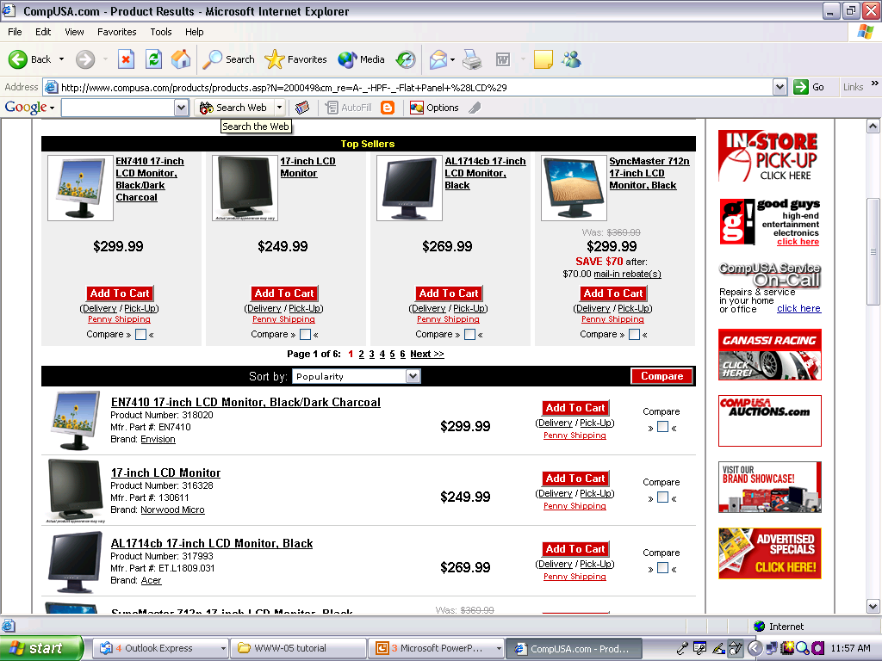
Web data extraction
Data region1
A data record
A data record
Data region2

Slide 22
Align and extract data items (e.g., region1)
image1 | EN7410 17-inch LCD Monitor Black/Dark charcoal |  | $299.99 |  | Add to Cart | (Delivery / Pick-Up ) | Penny Shopping | Compare
image2 | 17-inch LCD Monitor |  | $249.99 |  | Add to Cart | (Delivery / Pick-Up ) | Penny Shopping | Compare
image3 | AL1714 17-inch LCD Monitor, Black |  | $269.99 |  | Add to Cart | (Delivery / Pick-Up ) | Penny Shopping | Compare
image4 | SyncMaster 712n 17-inch LCD Monitor, Black | Was: $369.99 | $299.99 | Save $70 After: $70 mail-in-rebate(s) | Add to Cart | (Delivery / Pick-Up ) | Penny Shopping | Compare

Slide 23
Opinion Analysis
Word-of-mouth on the Web
The Web has dramatically changed the way that consumers express their opinions.
One can post reviews of products at merchant sites, Web forums, discussion groups, blogs
Techniques are being developed to exploit these sources.
Benefits of Review Analysis
  Potential Customer: No need to read many reviews
  Product manufacturer: market intelligence, product benchmarking

Slide 24
Feature Based Analysis & Summarization
Extracting product features (called Opinion Features) that have been commented on by customers.
Identifying opinion sentences in each review and deciding whether each opinion sentence is positive or negative.
Summarizing and comparing results.

Slide 25
An example
GREAT Camera., Jun 3, 2004
Reviewer: jprice174 from Atlanta, Ga.
I did a lot of research last year before I bought this camera... It kinda hurt to leave behind my beloved nikon 35mm SLR, but I was going to Italy, and I needed something smaller, and digital.
The pictures coming out of this camera are amazing. The 'auto' feature takes great pictures most of the time. And with digital, you're not wasting film if the picture doesn't come out. …
….
Summary:
Feature1: picture
Positive: 12
The pictures coming out of this camera are amazing.
Overall this is a good camera with a really good picture clarity.
…
Negative: 2
The pictures come out hazy if your hands shake even for a moment during the entire process of taking a picture.
Focusing on a display rack about 20 feet away in a brightly lit room during day time, pictures produced by this camera were blurry and in a shade of orange.
Feature2: battery life
…

Slide 26
Visual Comparison
+
Summary of reviews of Digital camera 1
_
Picture
Battery
Zoom
Size
Weight
+
Comparison of reviews of
Digital camera 1
Digital camera 2
_

Slide 27
Supervised Techniques
Classification:
-- k-Nearest Neighbors
--Naïve Bayes
--Classification Trees
--Descriminant Analysis
--Logistic Regression
--Neural Nets

Slide 28
Unsupervised Techniques
Cluster Analysis
Principle Components
Association Rules
Collaborative Filtering

Slide 29
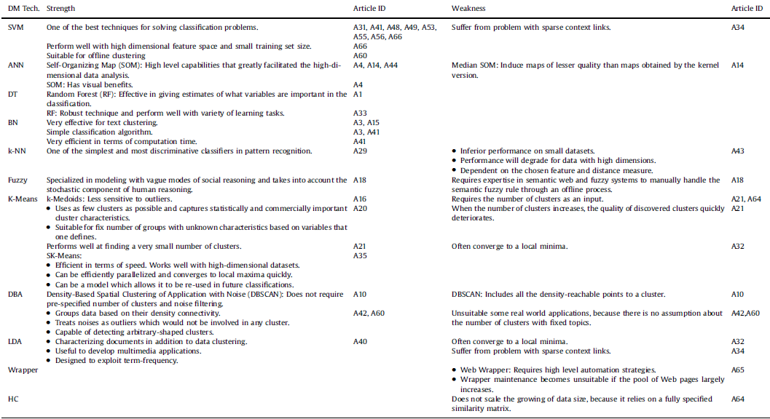

Slide 30
Thank You

